Slide 1
Employing Technology in Conducting Grounded Theory Research in Applied Linguistics
King Mongkut's University of Technology Thonburi
13 June 2014
Dr Bordin Chinda
English Department, Chiang Mai University, THAILAND
bordin.chinda@cmu.ac.th

Slide 2
Grounded Theory: Introduction
the methodology was first introduced by Glaser and Strauss (1967) in The Discovery of Grounded Theory
they, for the first time, made explicit the qualitative analytic procedures and research strategies

Slide 3
Grounded Theory: Introduction
Grounded Theory (GT)
a strategy of inquiry, consisting of
a set of data collection
analytic procedures
the researcher derives a general, abstract theory of a process, action, or interaction grounded in the views of the participants
Charmaz, 2004; Creswell, 2009

Slide 4
Grounded Theory: Introduction
‘grounded theory consists of guidelines that help researchers to study social and social psychological processes, direct data collection, manage data analysis, and develop an abstract theoretical framework that explains the studies’ process.’
Charmaz, 2002, p. 675

Slide 5
Grounded Theory: Introduction
there is no such thing as ‘grounded theory’ as a single, unified methodology, tightly defined and clearly specified
different interpretations of grounded theory
Glaser (1987)
Strauss (1987)
Strauss and Corbin (1990)
Others; e.g. Charmaz, 1990; Kools et al., 1996
Dey, 2004, p. 80

Slide 6
Grounded Theory: Introduction
Characteristics of GT
simultaneous data collection and analysis
pursuit of emergent themes through early data analysis
discovery of basic social processes within the data

Slide 7
Grounded Theory: Introduction
Characteristics of GT (Cont.)
inductive construction of abstract categories that explain and synthesize these processes
sampling to refine the categories through comparative processes
integration of categories into a theoretical framework that specifies causes, conditions, and consequences of the studied process
Charmaz, 2002, p. 677

Slide 8
Grounded Theory: Introduction
GT can be used to ‘direct the research process as well as provide a heuristic for data analysis and interpretation.’
Miller & Fredericks, 1999
in the TESOL field, GT offers a means of developing an understanding of an educational context without demanding the extended exposure for a full ethnography
Richard, 2003

Slide 9
GT for Data Analysis and Interpretation
Corbin and Strauss’s (2008) most recent work Basics of Qualitative Research: Techniques and Procedures for Developing Grounded Theory (3rd Edition).

Slide 10
GT for Data Analysis and Interpretation
techniques of employing GT as strategies
coding
open coding
axial coding
integrating categories and theory building
memoing

Slide 11
GT strategies: Coding
the process of generating, developing, and verifying concepts
the process of interpreting the data
more than just a paraphrasing, noting concepts in the margins of the field notes or making a list of codes as in a computer programme

Slide 12
GT strategies: Open Coding
Open Coding: analysing data for concepts
requires a brainstorming approach to analysis to open up the data to all potentials and possibilities contained within them
put interpretive conceptual labels on the data after having considered all possible meanings

Slide 13
GT strategies: Open Coding
Open Coding (Cont.)
these concepts represent the researchers’ impressionistic understanding of what is being described by the participants
concepts can range from lower-level concepts to higher-level concepts
higher-level concepts are called categories/theme
categories tell us what a group of lower-level concepts are pointing to or are indicating

Slide 14
GT strategies: Open Coding
Steps in constructing concepts
break the data into manageable pieces
take those pieces of data and explore them for ideas contained within (i.e. interpreting the data)
give those ideas conceptual names that stand for and represent the ideas contained in the data

Slide 15
GT strategies: Axial Coding
elaborating the analysis
the distinctions made between open coding and axial coding are artificial and for explanatory purposes only
open coding is breaking data apart and delineating concepts to stand for blocks of raw data
axial coding is the act of relating concepts/categories to each other

Slide 16
GT strategies: Axial Coding
in the process of open coding, while the researchers break data apart and identify concepts to stand for the data, in their minds, they automatically put the data back together and make connections by creating the explanatory descriptors –> doing axial coding
open coding and axial coding occur concurrently

Slide 17
GT strategies: Axial Coding
in linking the categories and making connections among them, the researchers also elaborate on them
linking could occur from a lower-level to a higher-level, similar to linking blocks to build a pyramid
elaborating on the analysis is the process in which the researcher explains this pyramid by explaining these blocks and how they are arranged

Slide 18
GT strategies: Integrating categories & theory building
Integrating categories
deciding upon a ‘central’ or ‘core’ category, which represents the main theme of the research
the concept that all other concepts are related to
the category that appears to have the greatest explanatory relevance and highest potential for linking all of the other categories together

Slide 19
GT strategies: Integrating categories & theory building
Theory building
a process of going from raw data to making statements of relationship about those concepts and linking them all together into a theoretical whole

Slide 20
GT strategies: Memoing
memos are a specialised type of written records – those that contain the products of the analyses
writing memos should begin with the first analytic session and continue throughout the analytic process
it is part of the analysis, part of doing qualitative research because they move the analysis forward
memos are fundamental representations of thought and grow in complexity, density, clarity, and accuracy as the research progresses

Slide 21
Case study: Open coding
listened to the interviews of each participant a few times to acquire a fresh the memory of the interviews
read the transcripts and typed up a summary of each of the interviews
read the transcripts again and paid particular interest in coming up with codes and possible categories

Slide 22
Case study: Open coding
underlined that incident and tried to understand what it meant to come up with a code
wrote down the code on the right margin of the transcript along with the summarised ideas for that particular code

Slide 23
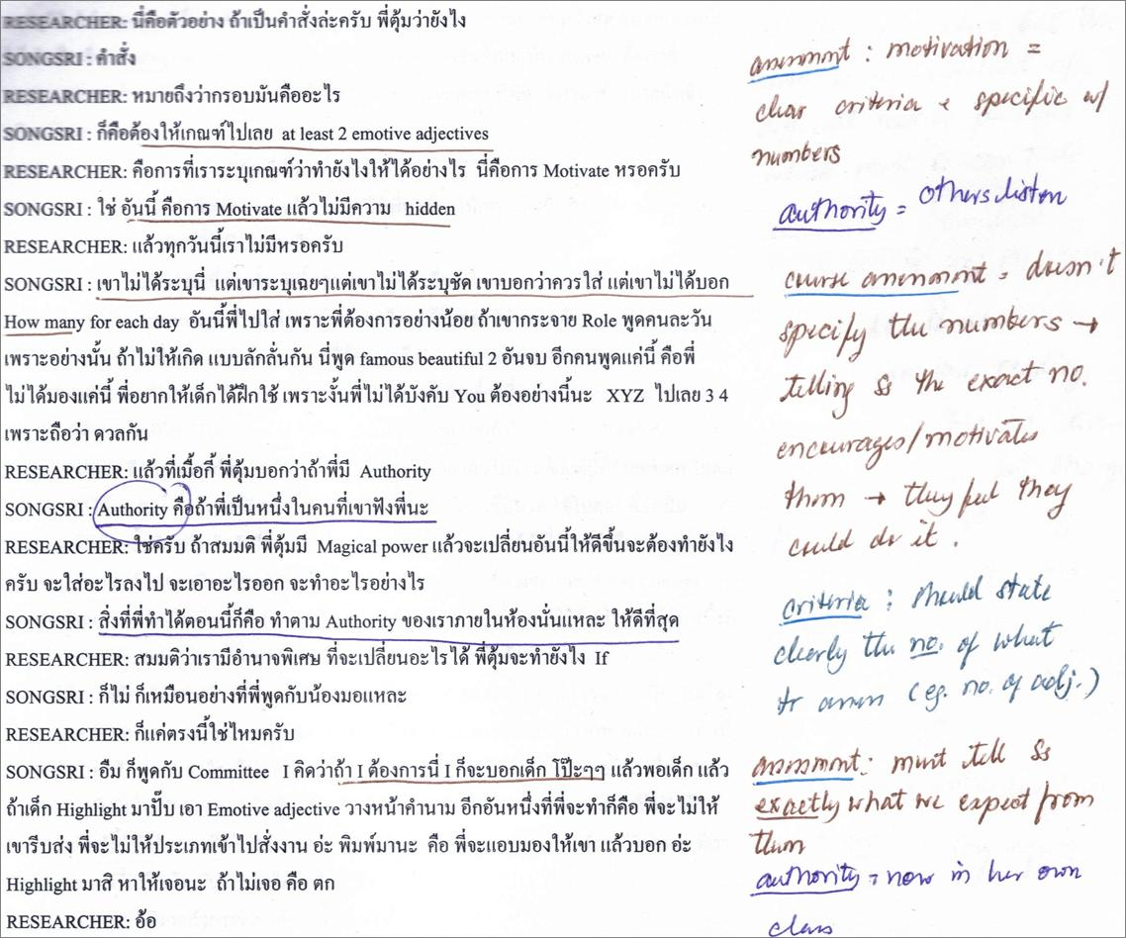
Case study: Open coding

Slide 24
Case study: Memoing and Axial coding
wrote memos of that participant after open coding one participant
In the memos
assigned code
paraphrased the incident under the code
noted down comments next to those incidents
while coding, assigned categories for the codes (doing axial coding)
annotations

Slide 25
Case study: Memoing and Axial coding
Memo 1
Belief in assessment: Traditional exam VS Performance assessment
Tanya thinks that traditional exam assesses student’s competence, including memorisation and grammar. It is ‘standard’ and easy to mark. On the other hand, performance assessment assesses student’s performances. Thus, the current assessment for the foundation courses assesses both competence and performance because the courses consist of final exam and performance assessment. Tanya also adds that some students are good at competence whereas some are good at performance. The question is whether the exams they use in the departments are ‘standard’ since they do not have any measure in standardising the exams. Perhaps, what Tanya means by ‘standard’ is that there is a standard marking, that is, objective marking.

Slide 26
Case study: Memoing and Axial coding
Annotation
New teacher: Enthusiastic in learning
It is important to note that Tanya is a new teacher. She has only been teaching at the department for 1 semester. This is also her first year of teaching career. During the time of the interview, she was holding part-time position. However, she has just gone through the assessment process of being a full-time, in which she would know the result that she passed in a few weeks’ times. As being a part-timer, Tanya is very enthusiastic in learning as reflected by the fact that she wants to become a full-time and has decided to participate in this PD. Generally speaking, part-time teachers do not engage in academic activities in the department.

Slide 27
NVivo
a qualitative data analysis (QDA) computer software package produced by QSR International
designed for qualitative researchers working with very rich text-based and/or multimedia information, where deep levels of analysis on small or large volumes of data are required

Slide 28
NVivo
allows users to
classify, sort and arrange information
examine relationships in the data
combine analysis with linking, shaping, searching and modeling
test theories
identify trends and cross-examine information
make observations and build a body of evidence to support their case or project

Slide 29
Nvivo: case study
imported the codes into NVivo 8 software
while importing the codes from the word documents into NVivo, changed the wording of the codes and the categories
created hierarchical relationships between the codes and categories
re-coded the interview transcriptions.

Slide 30
Nvivo: case study
more investigation of the data in an in-depth analytical manner by comparing and contrasting the structures of the codes
using NVivo was a great advantage because the software could illustrate the tree nodes (node is a term for codes used in NVivo) of the coding scheme

Slide 31
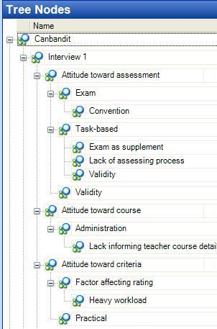
NVivo: case study

Slide 32
NVivo: case study
the ‘models’ facility of NVivo to have a visual representation of the categories and codes, which would later help with the coding tree structure outputs, refined the categories and codes

Slide 33
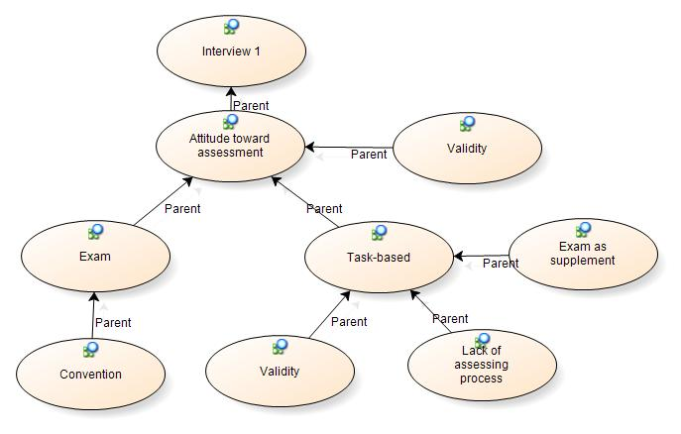
NVivo: case study

Slide 34
NVivo: case study
studied both tree nodes and map representations of the coding structures
edited some codes and categories by making changes to the titles as well as moving some codes to appropriate categories
re-coded the interview transcripts using a theme approach

Slide 35
NVivo: case study
transferred the codes into Nvivo
repeated the same analytic procedures in comparing and contrasting the codes and categories
came up with a new set of codes and categories.

Slide 36
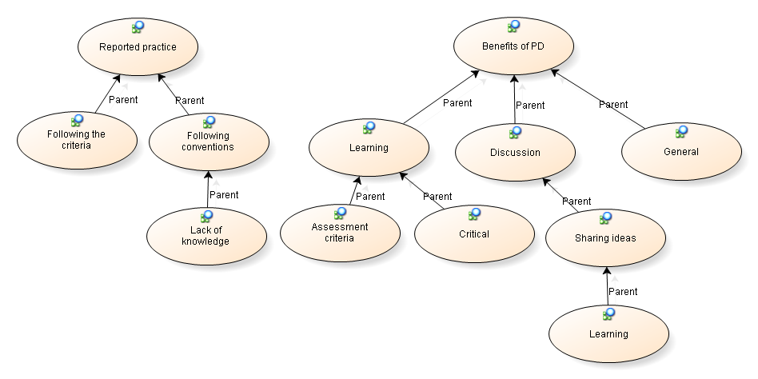
NVivo: case study (model of categories and codes

Slide 37
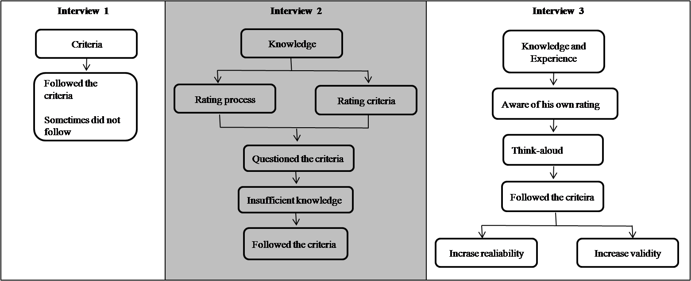
NVivo: case study (integrating categories)

Slide 38
Issues of Validity and Reliability of the Qualitative analysis
Strategies to ensure the quality of qualitative research:
Building up an image of researcher integrity through
audit trails
contextualisation and thick description
identifying potential researcher bias or examining outliers, extreme or negative cases and alternatives explanations
Validity/reliability checks by
incorporating respondent feedback
member and/or peer checking into research designs

Slide 39
Issues of Validity and Reliability of the Qualitative analysis
Research design-based strategies
method and data triangulation
prolonged engagement
persistent observation
longitudinal research designs
Dörnyei (2007, pp. 59 - 62)

Slide 40
Issues of Validity and Reliability of the Qualitative analysis
Case study:
providing an ‘audit trail’, which is ‘created by documentation of the research process and by provision of sufficient evidence to understand how the researcher reached the conclusion of the study’
Morrison & Hamp-Lyons, 2007
member checking, that is sending my overview of the data to the participants and asking them to critically analyse and comment on the data

Slide 41
Issues of Validity and Reliability of the Qualitative analysis
offering a detailed description of research methodology
providing the detailed description of my roles of the researcher
collecting the data during a series of points in time; in other words, being a longitudinal research

Slide 42
References
Charmaz, K. (2002). Qualitative interviewing and grounded theory analysis. In J. F. Gubrium & J. A.Holstein (Eds.), Handbook of interview research: Context & method (pp. 675-694). Thousand Oaks, CA: Sage.
Charmaz, K. (2004). Grounded theory. In S. Hesse-Biber & P. Leavy (Eds.), Approaches to qualitative research: a reader on theory and practice (pp. 496-521). New York, NY: Oxford University Press.
Corbin, J., & Strauss, A. (2008). Basics of qualitative research: Techniques and procedures for developing grounded theory (3rd ed.). Thousand Oaks, CA: Sage.
Creswell, J. W. (2009). Research design: Qualitative, qualitative, and mixed methods approaches. Thousand Oaks, CA: Sage.
Dey, I. (2004). Grounded theory. In C. Seale, G. Gobo, J. F. Gubrium & D. Silverman (Eds.), Qualitative research practice (Concise Paperback ed., pp. 80-93). London: Sage.
Miller, S. I., & Fredericks, M. (1999). How does grounded theory explain? Qualitative Health Research, 9(4), 538-551.
Morrison, B., & Hamp-Lyons, L. (2007). Grounded theory research: increasing accountability and credibility through the use of the 'worked example'. The International Journal of Interdisciplinary Social Sciences, 2(3), 413-424.
Richards, K. (2003). Qualitative inquiry in TESOL. Basingstoke: Palgrave Macmillan.

